Slide 1


Total Fertility Rate
teams
history
Analysis 4
timeline
about
Analysis 3
Analysis 2
Analysis 1
My Project
About
R Project By Dhivya Murugesan

Slide 2
Total Fertility Rate
Total Fertility Rate (TFR) – which measures the average number of children per woman.
The global average fertility rate is just below 2.5 children per woman today.
Over the last 50 years the global fertility rate has halved.
Over the course of the modernization of societies the number of children per woman decreases very substantially.
In the pre-modern era fertility rates of 4.5 to 7 children per woman were common.
At that time the very high mortality at a young age kept population growth low. As health improves and the mortality in the population decreases we typically saw accelerated population growth.
This rapid population growth then comes to an end as the fertility rate declines and approaches 2 children per woman.
teams
history
timeline
about
Analysis 4
About
Analysis 3
Analysis 2
Analysis 1
My Project

Slide 3
Project Summary
Dataset – World Bank
Countries with high fertility rate in 1800 and their corresponding fertility rate in 2015.
Countries with high fertility rate in 2015 and their respective values in 1800.
Found the total number of countries with similar fertility rates in the year 1800 and 2015.
Monitored the rate at which fertility rate of a country moves along the scale.
Picked a handful of countries that should a drastic change in the fertility rate.
Fertility rates are not the same for a country through the period 1800 – 2015.
teams
history
Analysis 4
timeline
about
Analysis 3
Analysis 2
Analysis 1
My Project
About

Slide 4
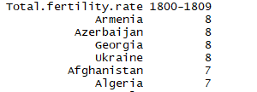
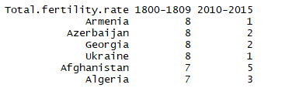
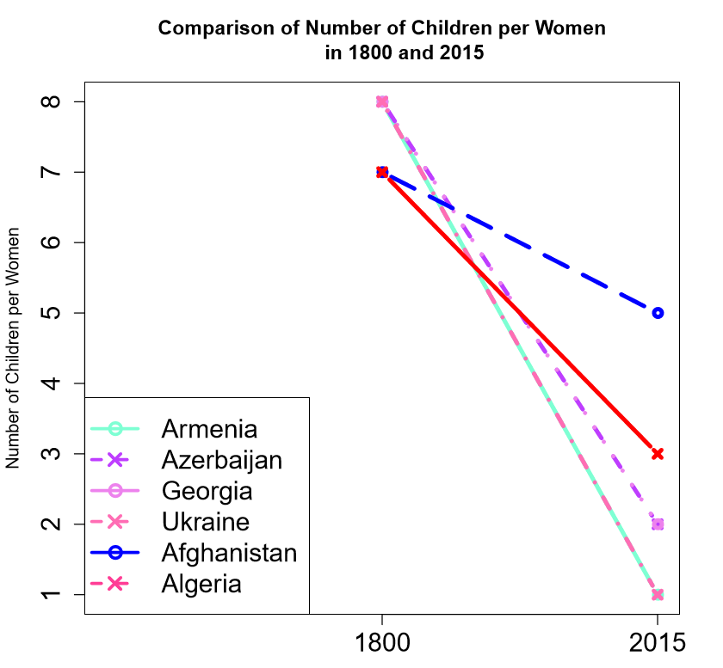
High Fertility Rate - 1800
teams
history
Analysis 4
timeline
about
Analysis 2
Analysis 1
My Project
Analysis 3
About

Slide 5
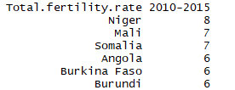
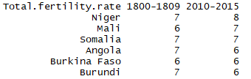
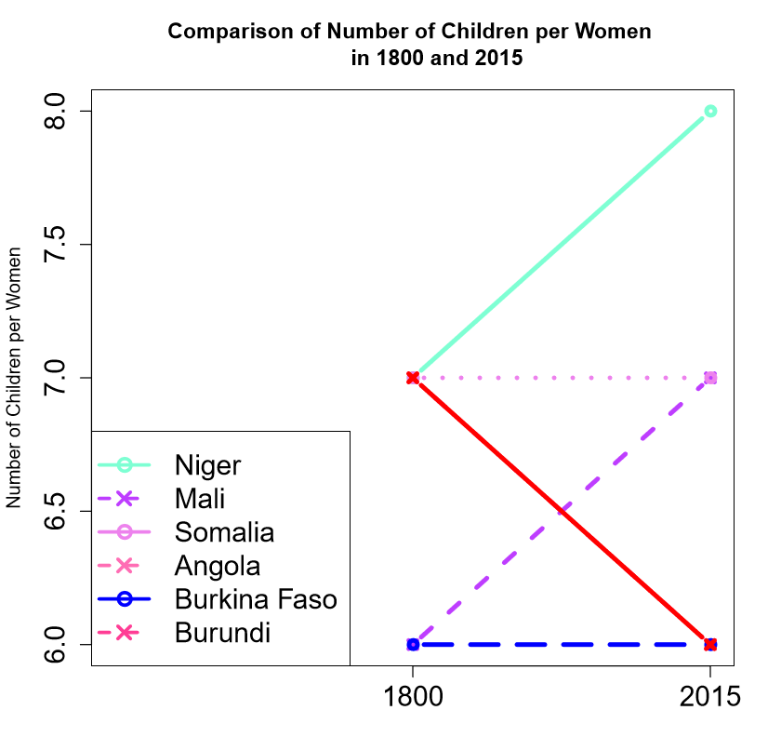
High Fertility Rate - 2015
teams
history
Analysis 4
timeline
about
Analysis 3
Analysis 2
Analysis 1
My Project
About

Slide 6
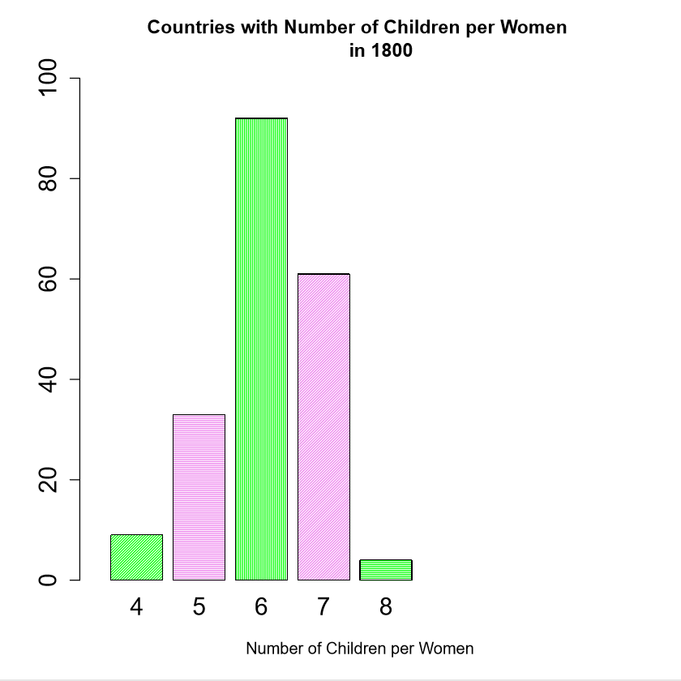
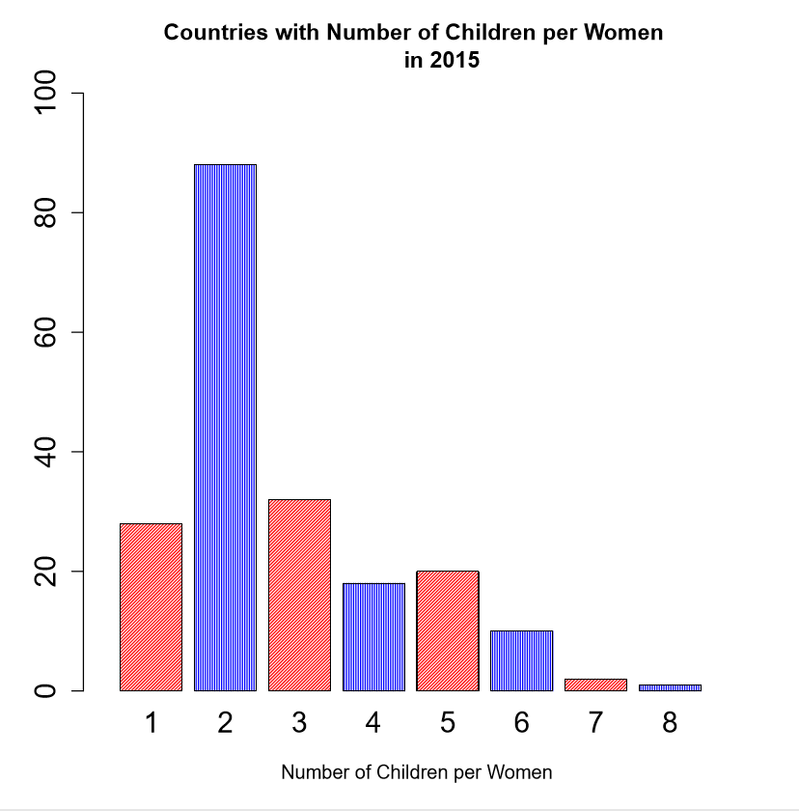
Fertility Rates – A Comparison
teams
history
Analysis 4
timeline
about
Analysis 3
Analysis 2
Analysis 1
My Project
About

Slide 7
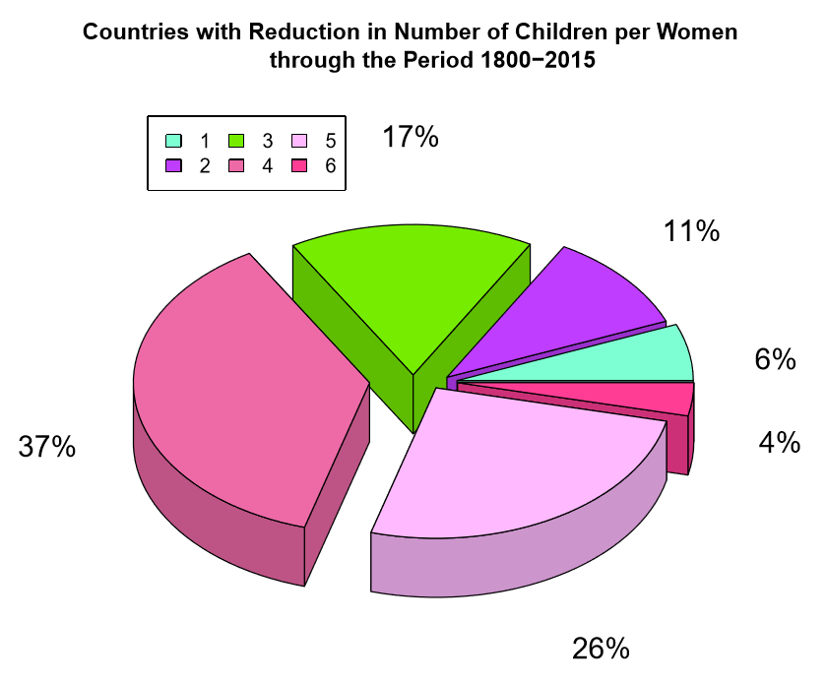
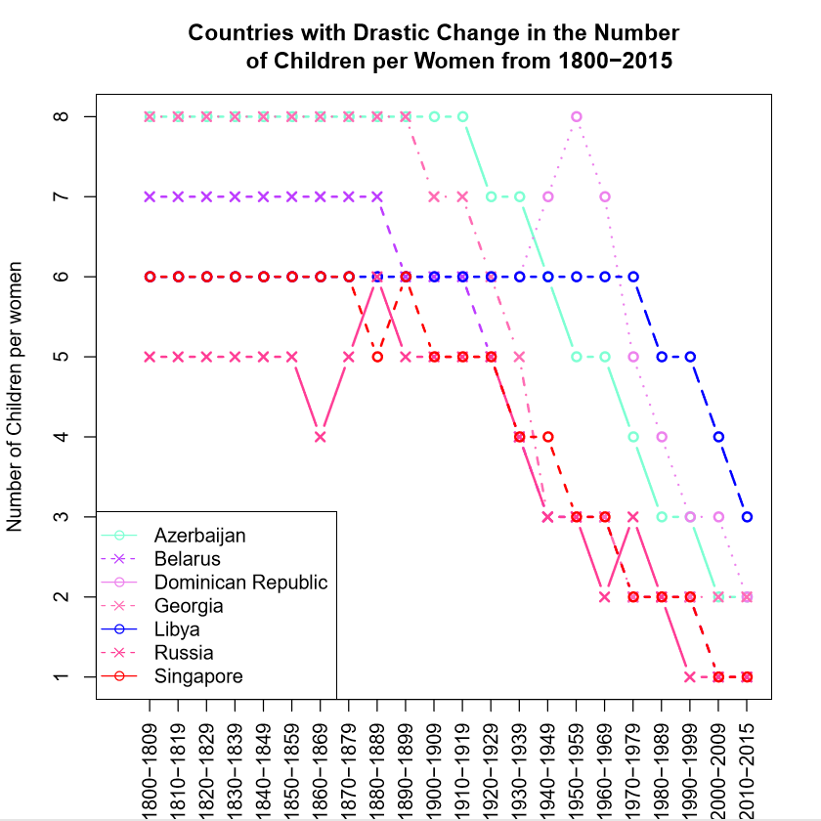
Drastic Changes - Factor
teams
history
Conclusion
Analysis 4
timeline
about
Analysis 3
Analysis 2
Analysis 1
My Project
About

Slide 8
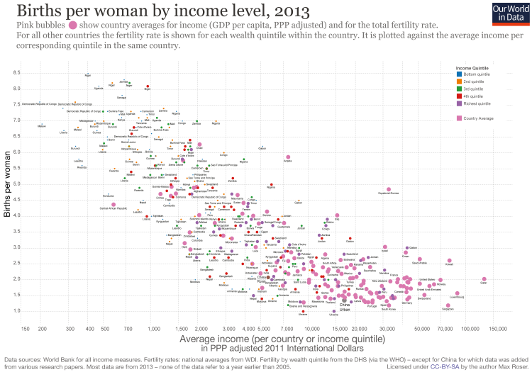
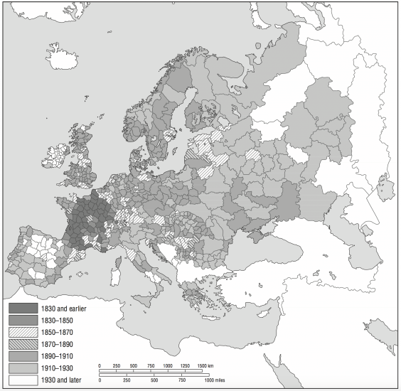
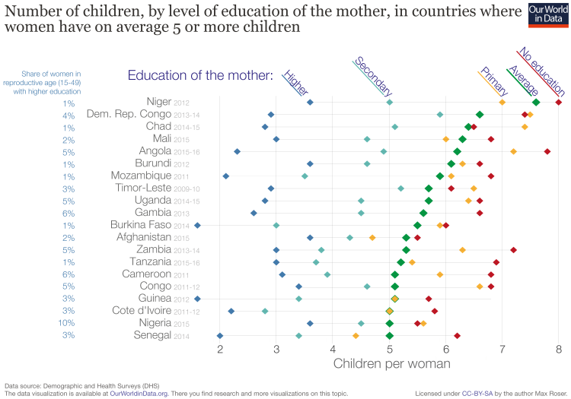
Women Empowerment
Women have a lower social status and few opportunities outside the household.
Women’s better education and women’s increased employment opportunities both changed the role of women in society and increased the social status of women in society. With more outside-options to having a large number of children women opted increasingly to take advantage of these options and consequentially the total fertility rate declined.
The good thing about this is that these changes are desirable in their own right.
This makes clear that one of the best strategies to achieve lower fertility rates is to work towards Reducing gender inequality and supporting women's empowerment and a rise of women’s power, status, and education relative to men.
teams
history
Analysis 4
timeline
about
Conclusion
Analysis 3
Analysis 2
Analysis 1
My Project
About

Slide 9
Thank you
teams
history
Dhivya Murugesan
mdhivya.it@gmail.com
Analysis 4
timeline
about
Conclusion
Analysis 3
Analysis 2
Analysis 1
My Project
About

